Slide 1
PRESENTS

Slide 2
It is an open-world game based on survival, colonization, and terraforming on Mars. It features both single and multiplayer co-op gameplay.
Included Game Modes:
Single Story
Multiplayer Survive *First Person / Shooter
*Openworld Survive / Crafting&Building "AA Plus" is a game where survival skills are
enhanced and equipped with elements of exploration. Average Gameplay Duration is 50 hours.
Support for 9 different languages. Full controller support (xBox +/- 7.Gen) Target Minimum system requirement (GTx1060 & Derivatives) Targeted Release Date 2024/July
GAME GENRE
Targeted Derivative Games: No Man Sky / Subnautica / Astroneer

Slide 3
TARGETED PLATFORMS

Slide 4
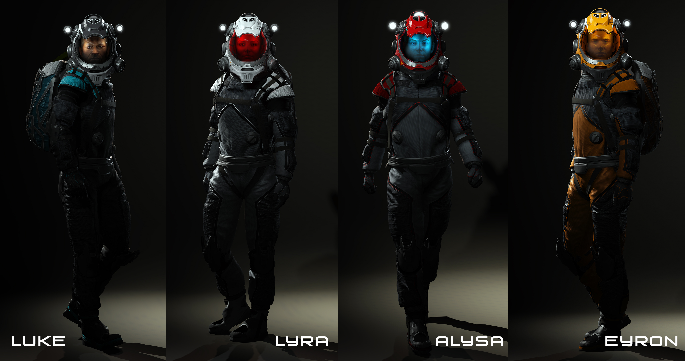
Costume Color Customization Options
Characters

Slide 5
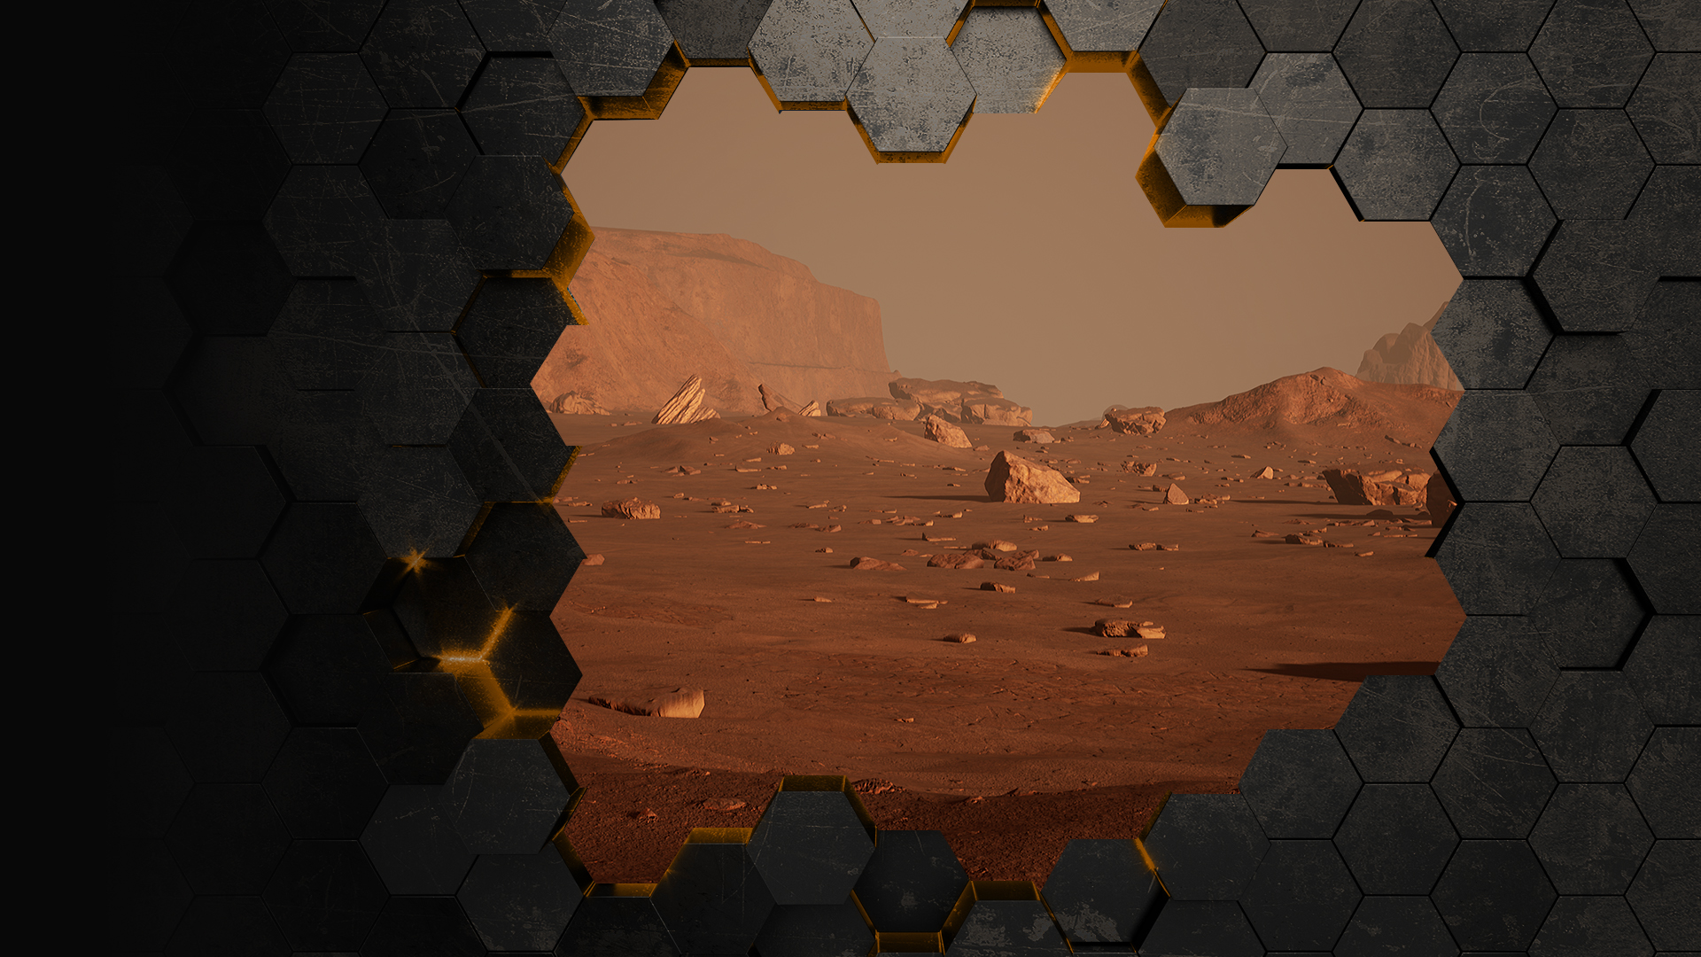
Mars Map Size 2,181 km²
Open World Mars Map
The entire environment of Mars has been created based on real images obtained from NASA, including the environmental setting and lighting.
Ingame Footage

Slide 6
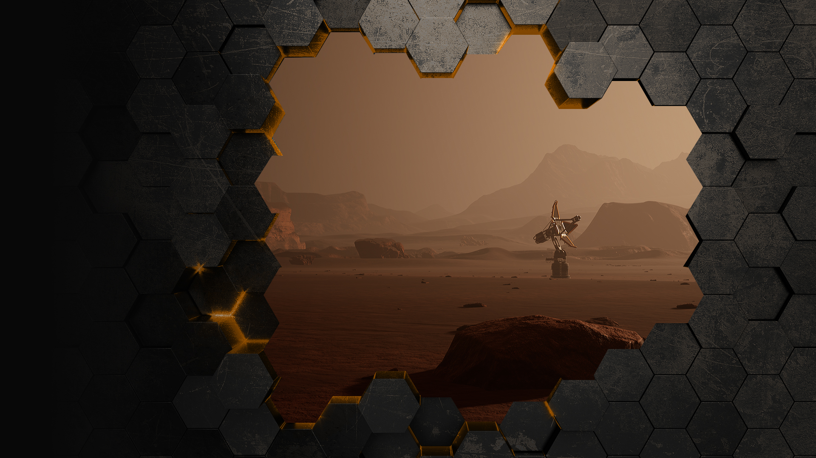
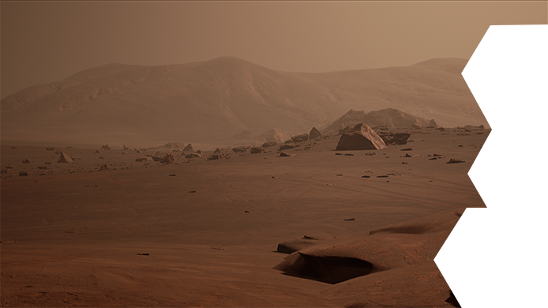
It has to be built for the Mission (Quest) System
World Communication Satellite
Ingame Footage

Slide 7
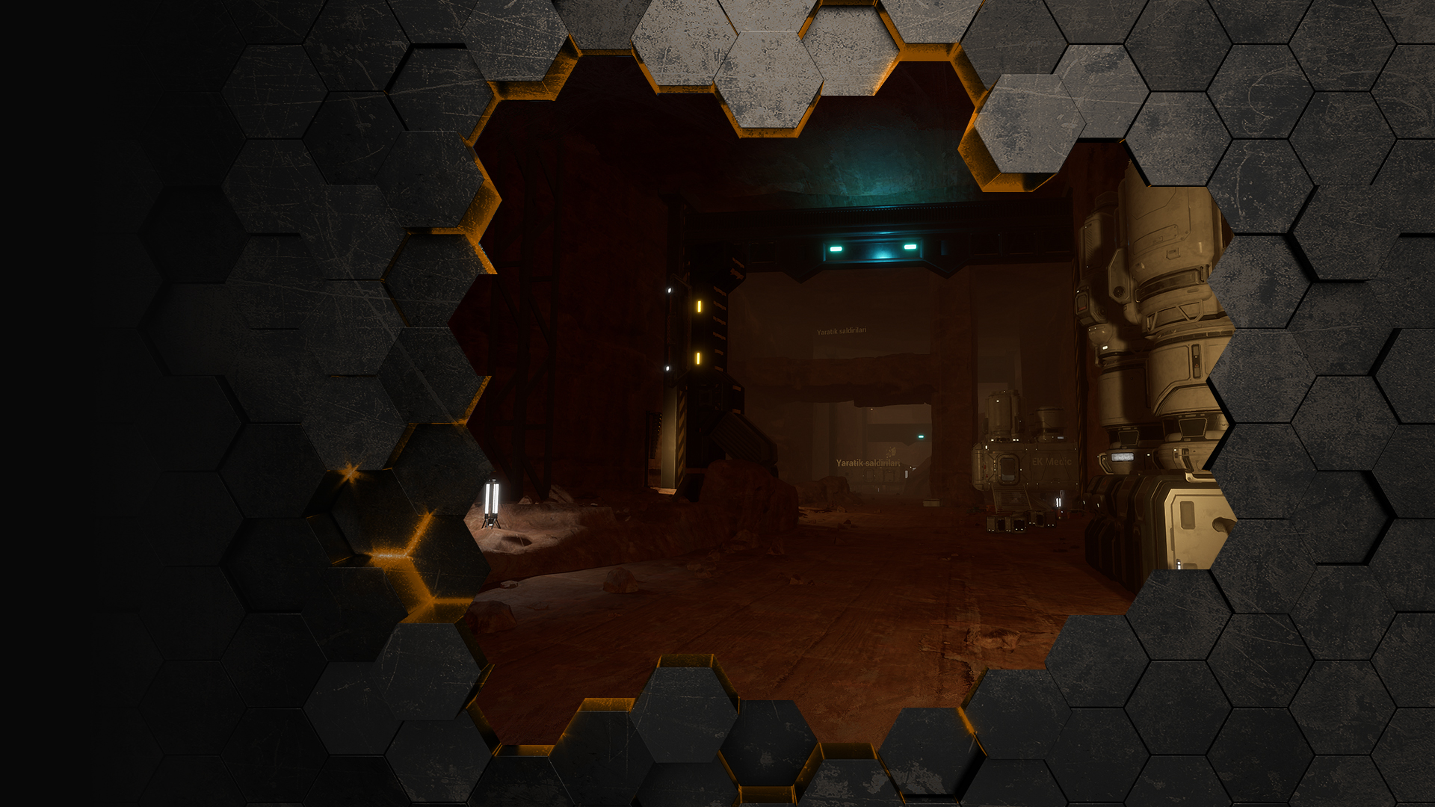
The game is set in the year 2079. Our team embarks on the 17th Endeavor mission.
In the quest for Martian colonization, we explore the remnants and discoveries of past expedition missions by visiting old colony areas.
Various resources, such as minerals, can be gathered from these locations.
In this image, we are delving into the underground resources of Mars and visiting old colonization zones.
Ingame Footage
Open World Mars Map

Slide 8
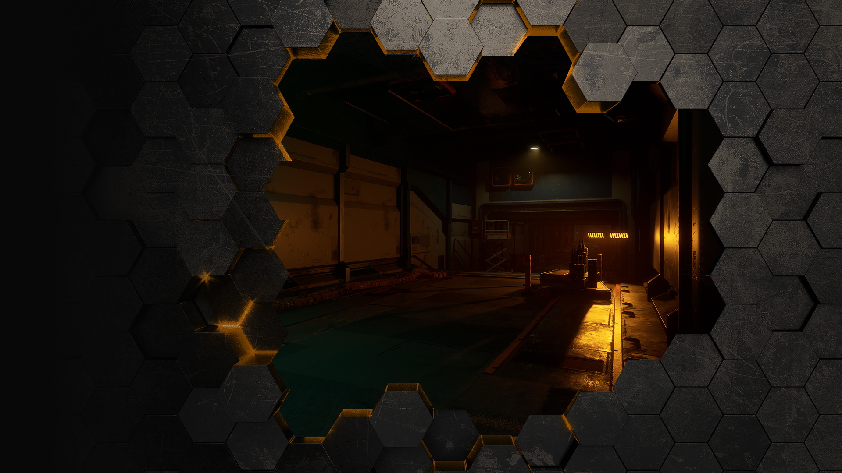
Mars Endeavor 11's Underground Research Facility.
Open World Mars Map
Ingame Footage
Ingame Footage

Slide 9
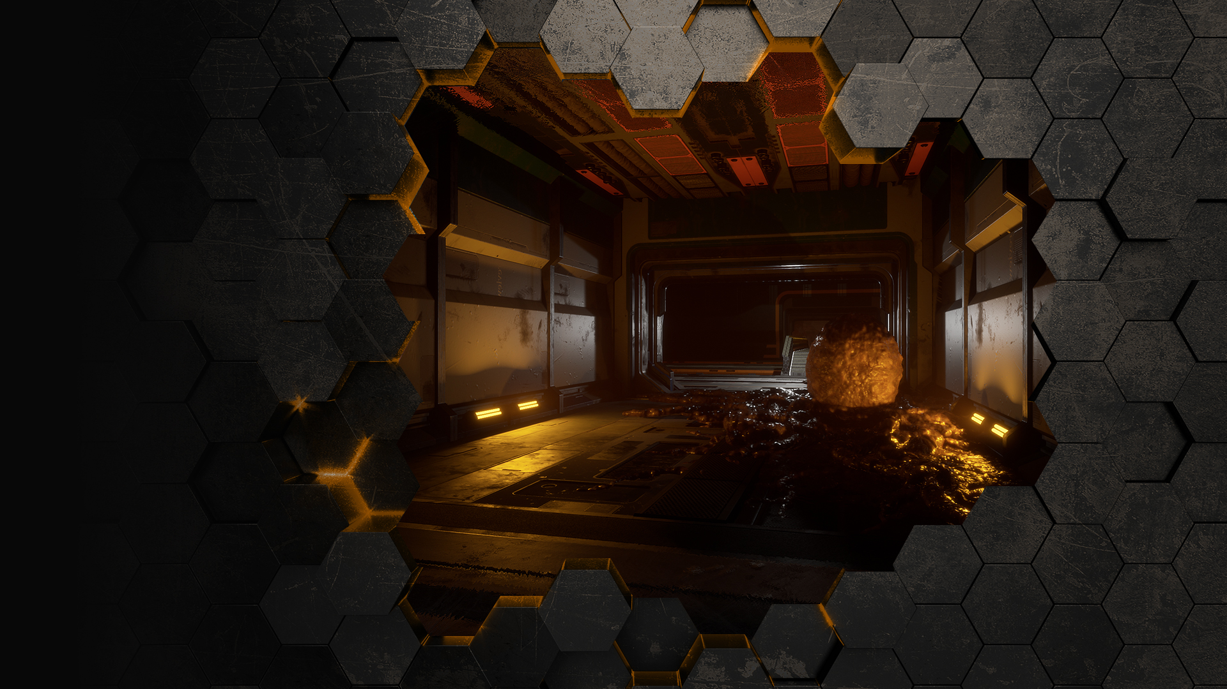
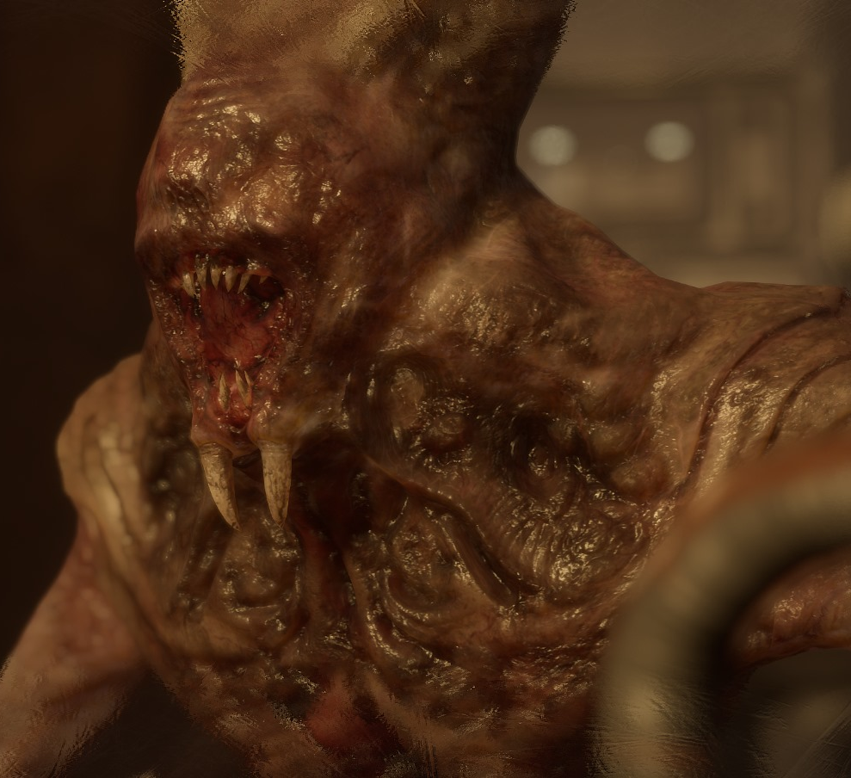
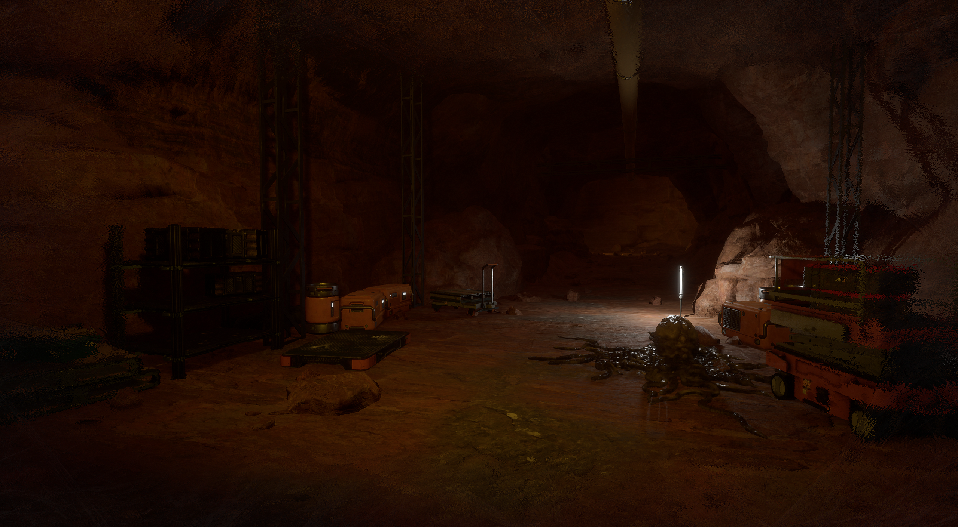
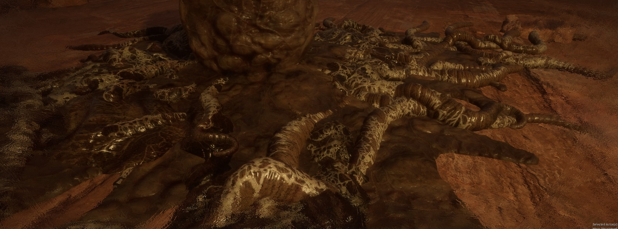
In the underground facilities and various regions, there are creature eggs and larvae. Additionally, when excessive noise is made, they explode, and the creatures emerge to begin attacking.
Creature AI – InGame Footage

Slide 10
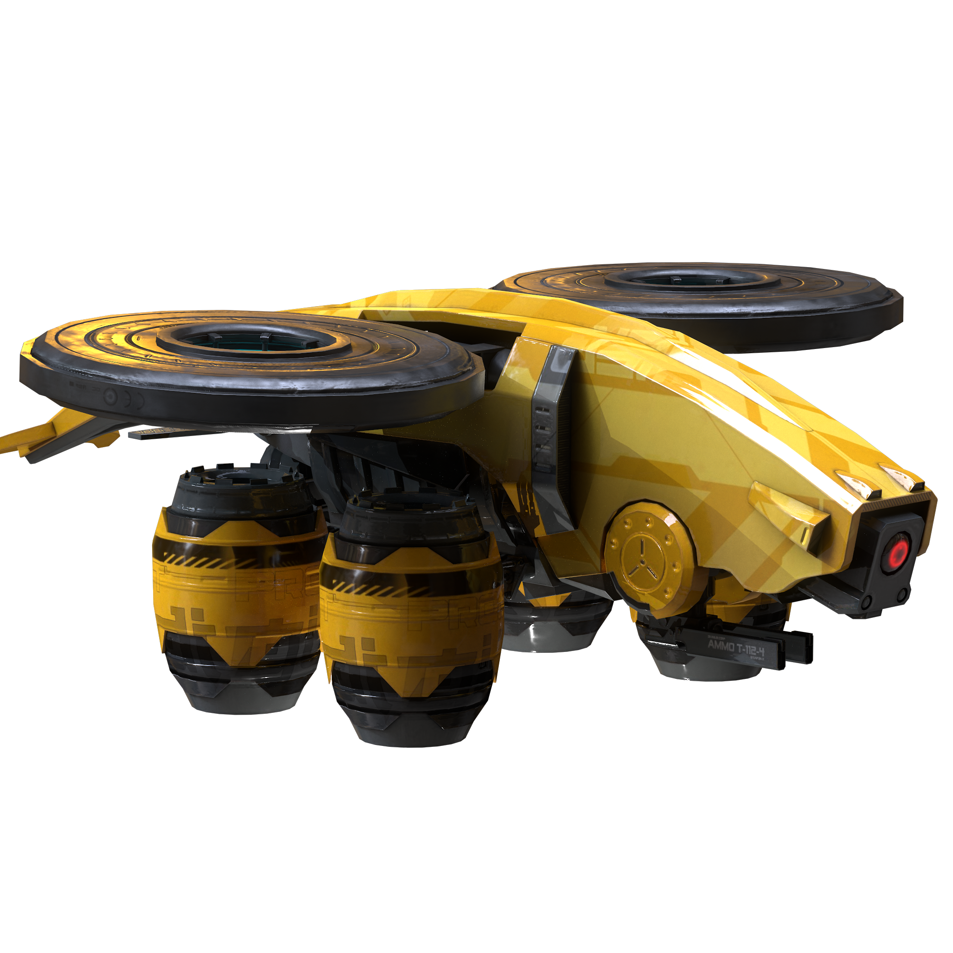
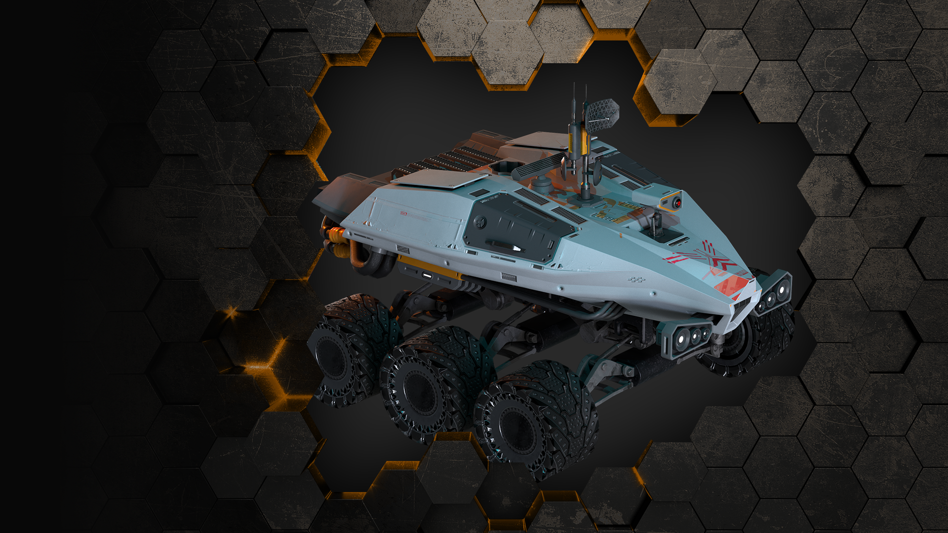
Moving away from colony zones complicates survival, so accessing remote areas is challenging.
To explore these distant regions, they can be discovered by remotely scanning with a rover. (It includes features such as area marking, different vision systems, and field scanning.) Thermal Vision Night Vision Mining Dredging Scanner
Vehicles – Remote

Slide 11
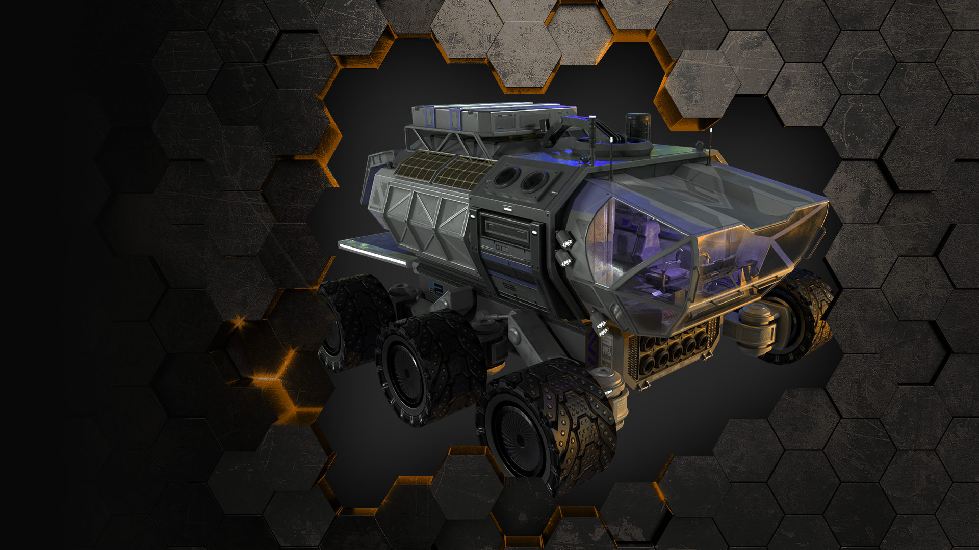
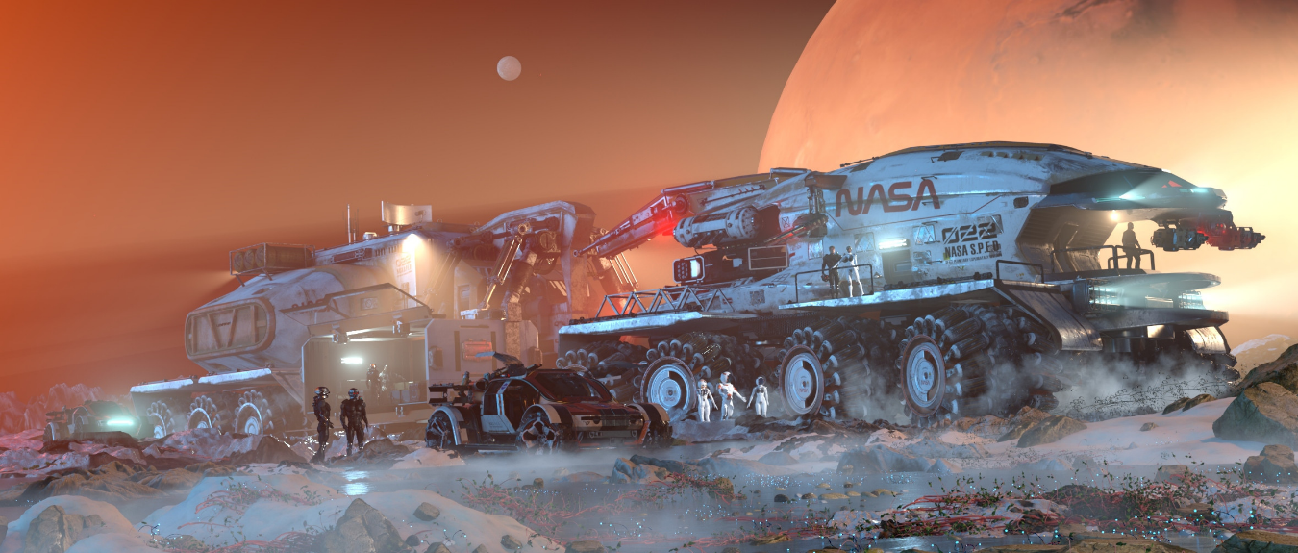
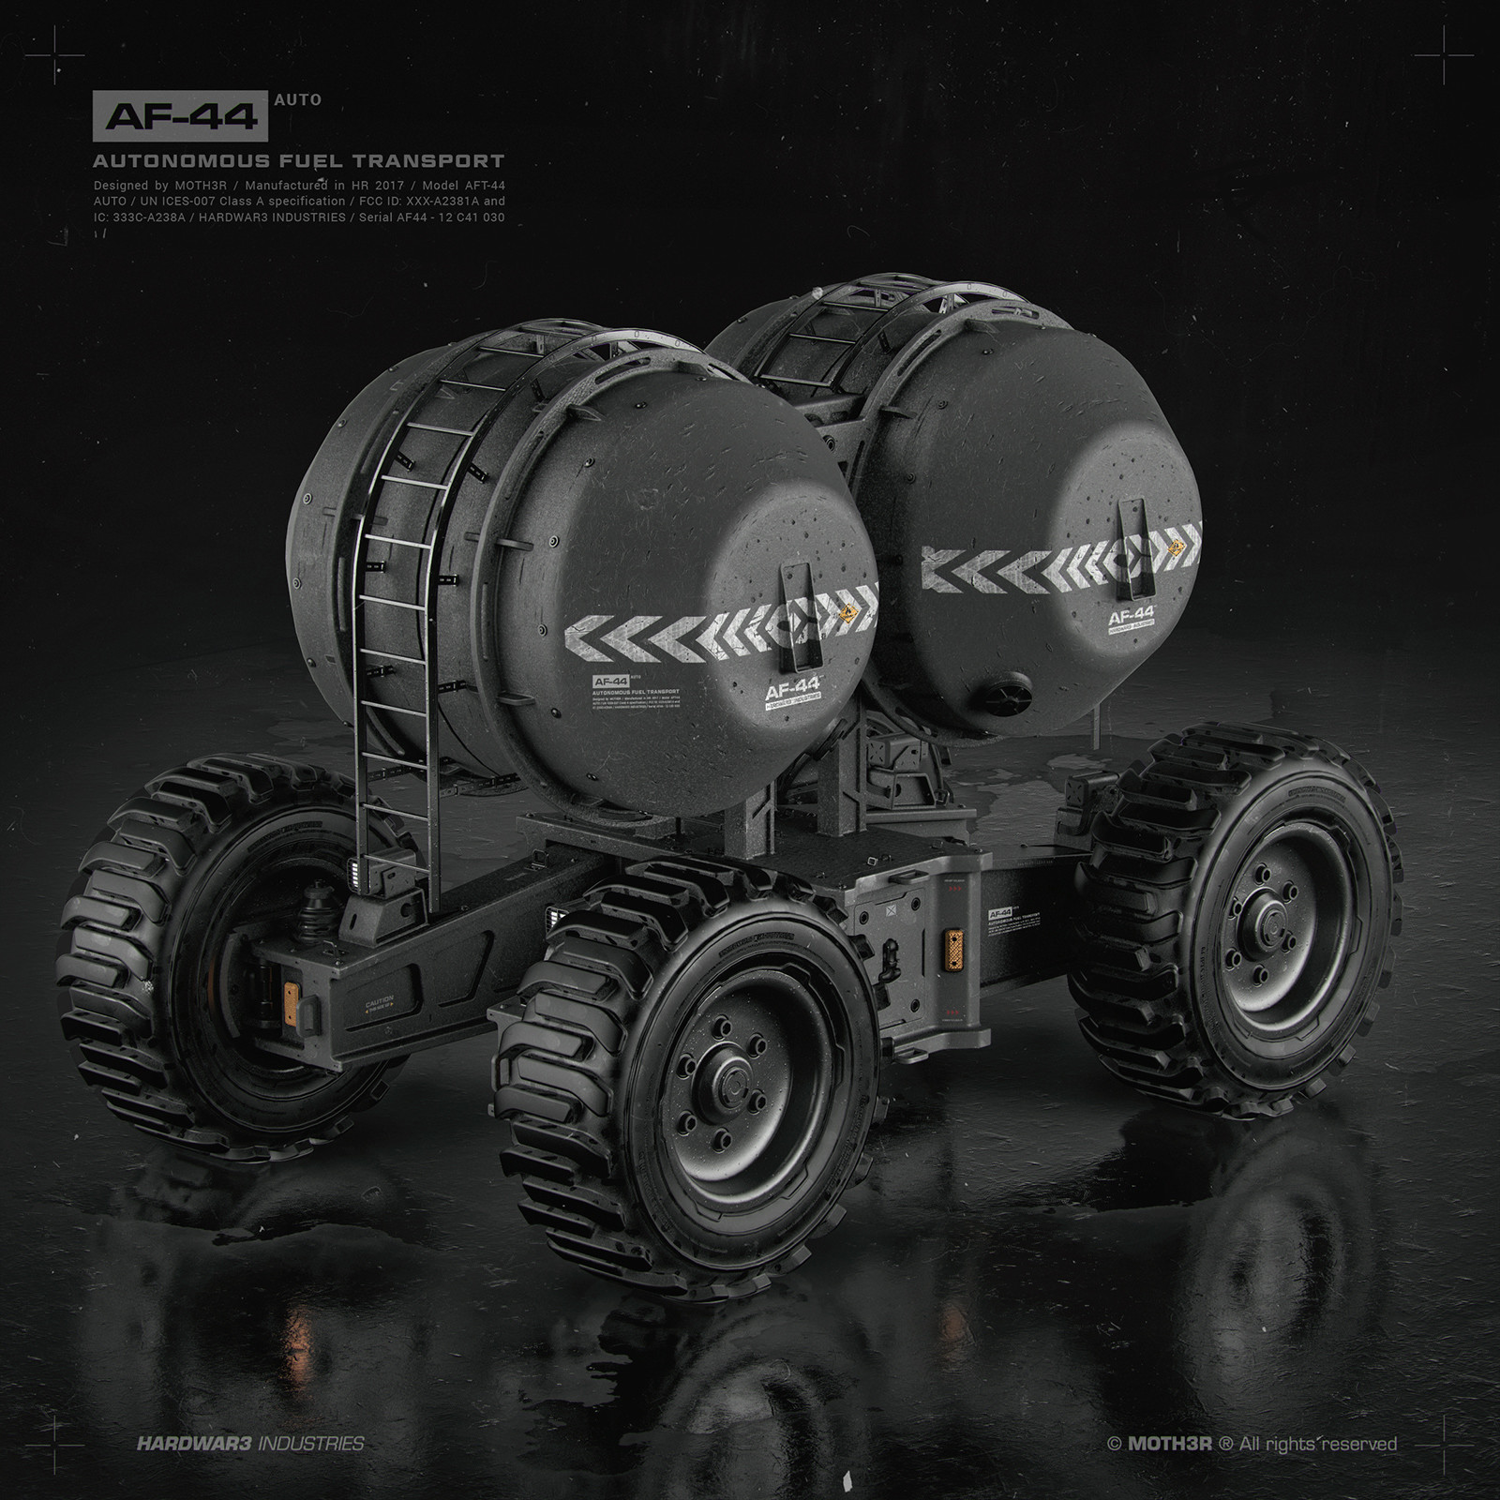
It will be included.
Designed for remote areas, the large guardians feature expanded compartments and all the necessary reservoirs for survival.
Embark on a journey, collecting financial assets and valuable minerals in the open world, adjusting resource ratios.
Unknown technological components must be discovered to separate resource classes in the game.
These tools are tailor-made for this purpose.
Vehicles – Ranger&Kit

Slide 12
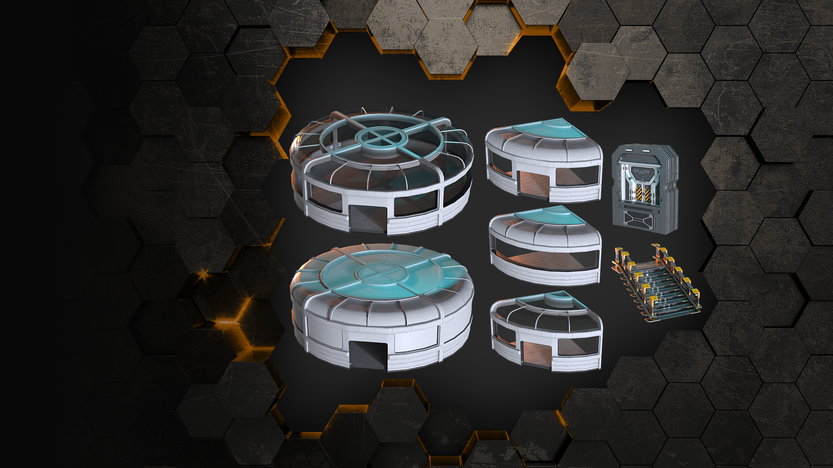
The building system consists of primary components.
Once the main structures are established, each compartment's structure can be customized individually. The building system is organized in the form of both structures and compartments.
Building Structures/Partition

Slide 13
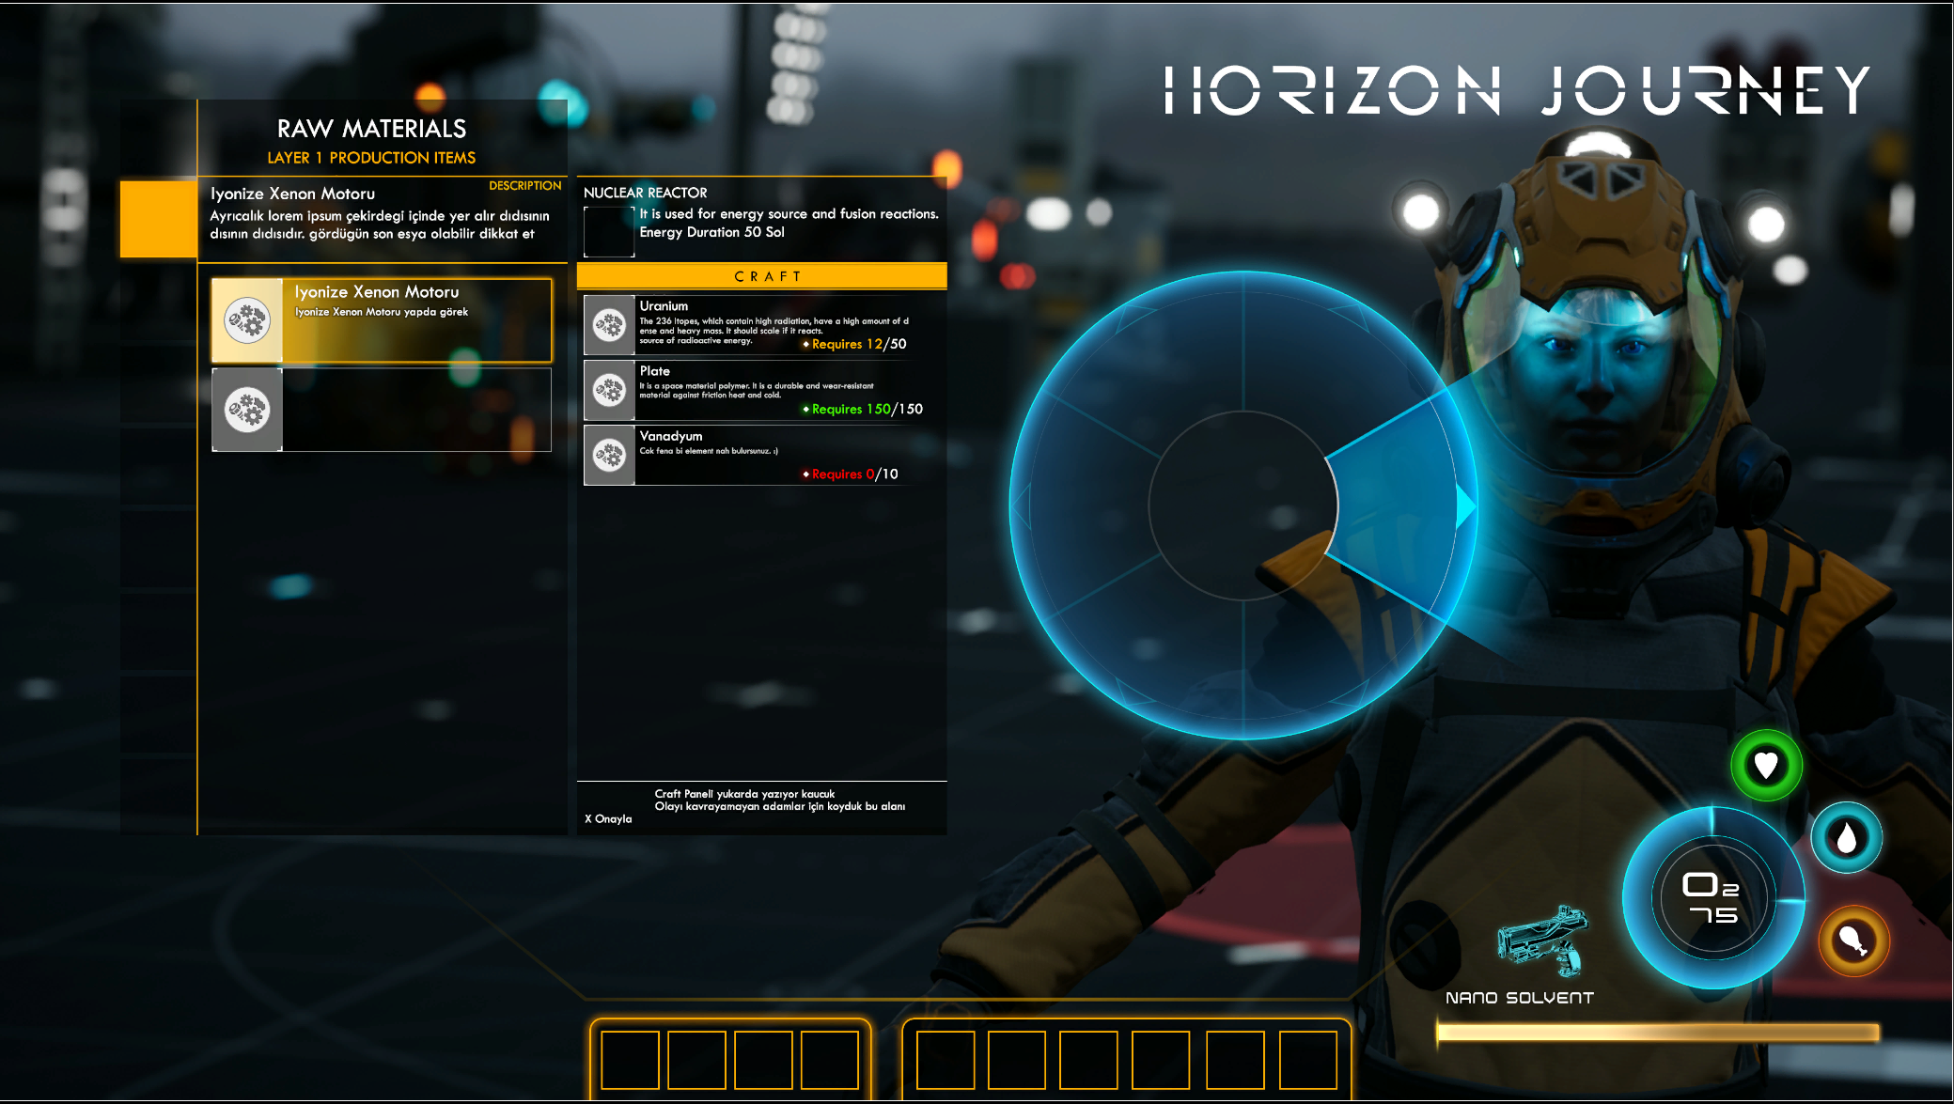
Crafting Panel: Consisting of 3 Layers: Crafting panel 1 Layer: Raw Materials: Excavations obtained from mineral deposits in the game.
2 Layer: Interim Components These components are branched and used in different developments.
3 Layer: Main Components allow us to obtain Product resources by combining them with the other sub-layer.

Slide 14
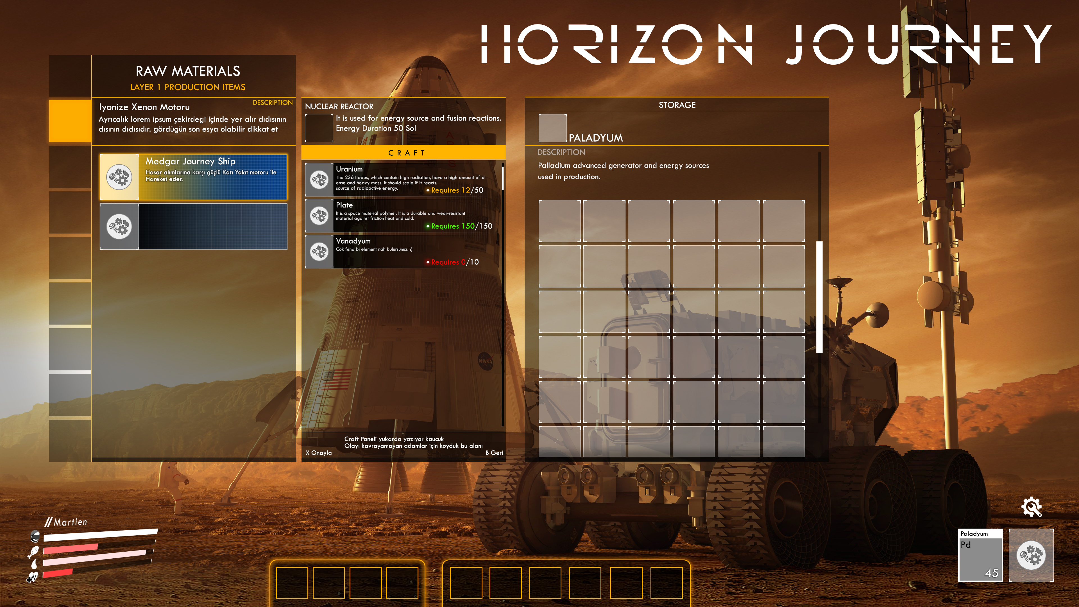
//Main Crafting Panel
*Raw Material *Interim component
*Main Component *Survival Resources *Support Evolve *Product Resources *Vehicles *Space Ship Components

Slide 15
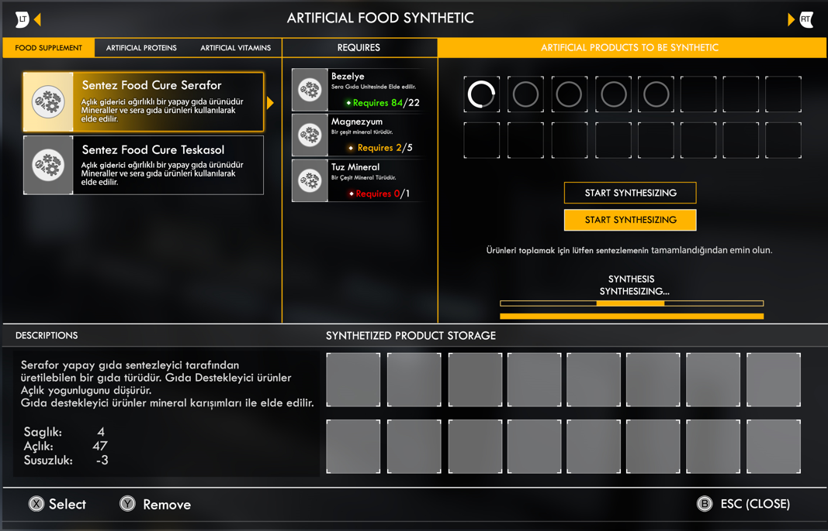
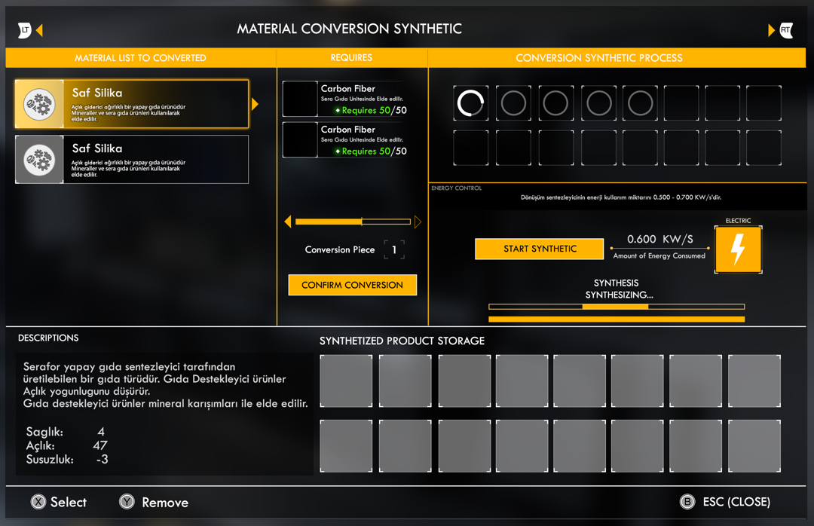
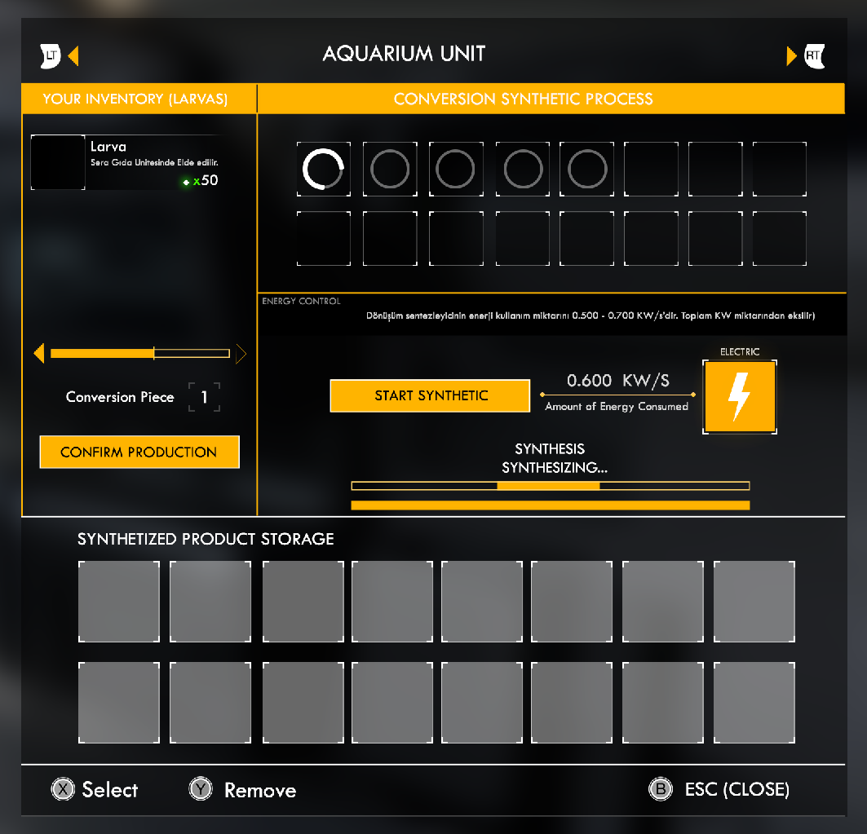
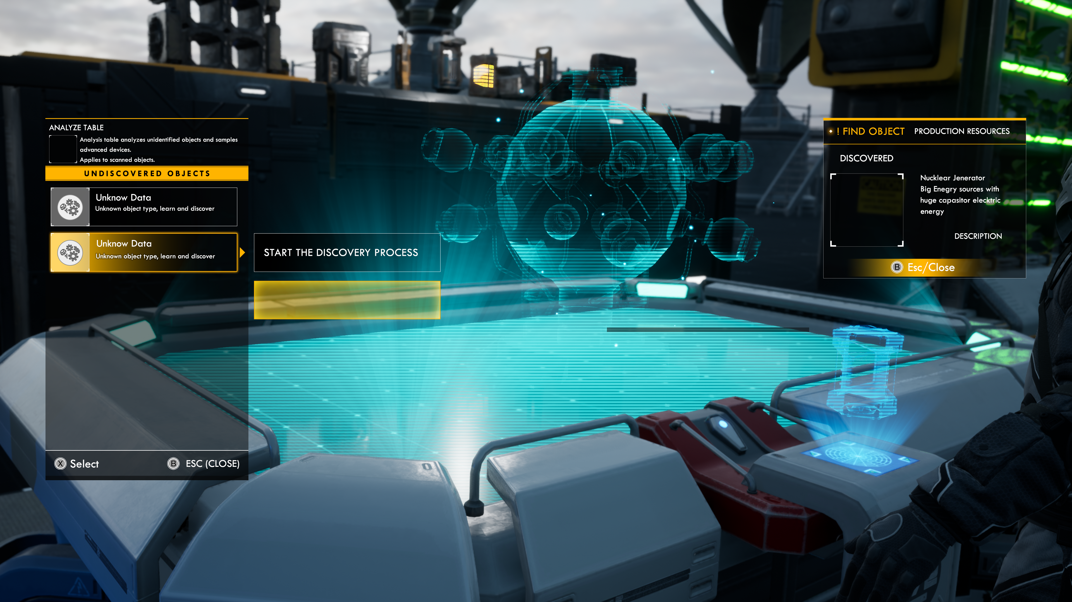
Some Product Resources Units of certain product resources in the game belong to (Build Structures) panels.
*Artificial Food Synthesizer
*Material Conversion Synthesizer
*Aquarium Unit
*Analysis Table
There are 161 craft-based unique production modifications.
All product resources are connected to the colonization's electrical system; the electrical system requires feeding energy sources.

Slide 16
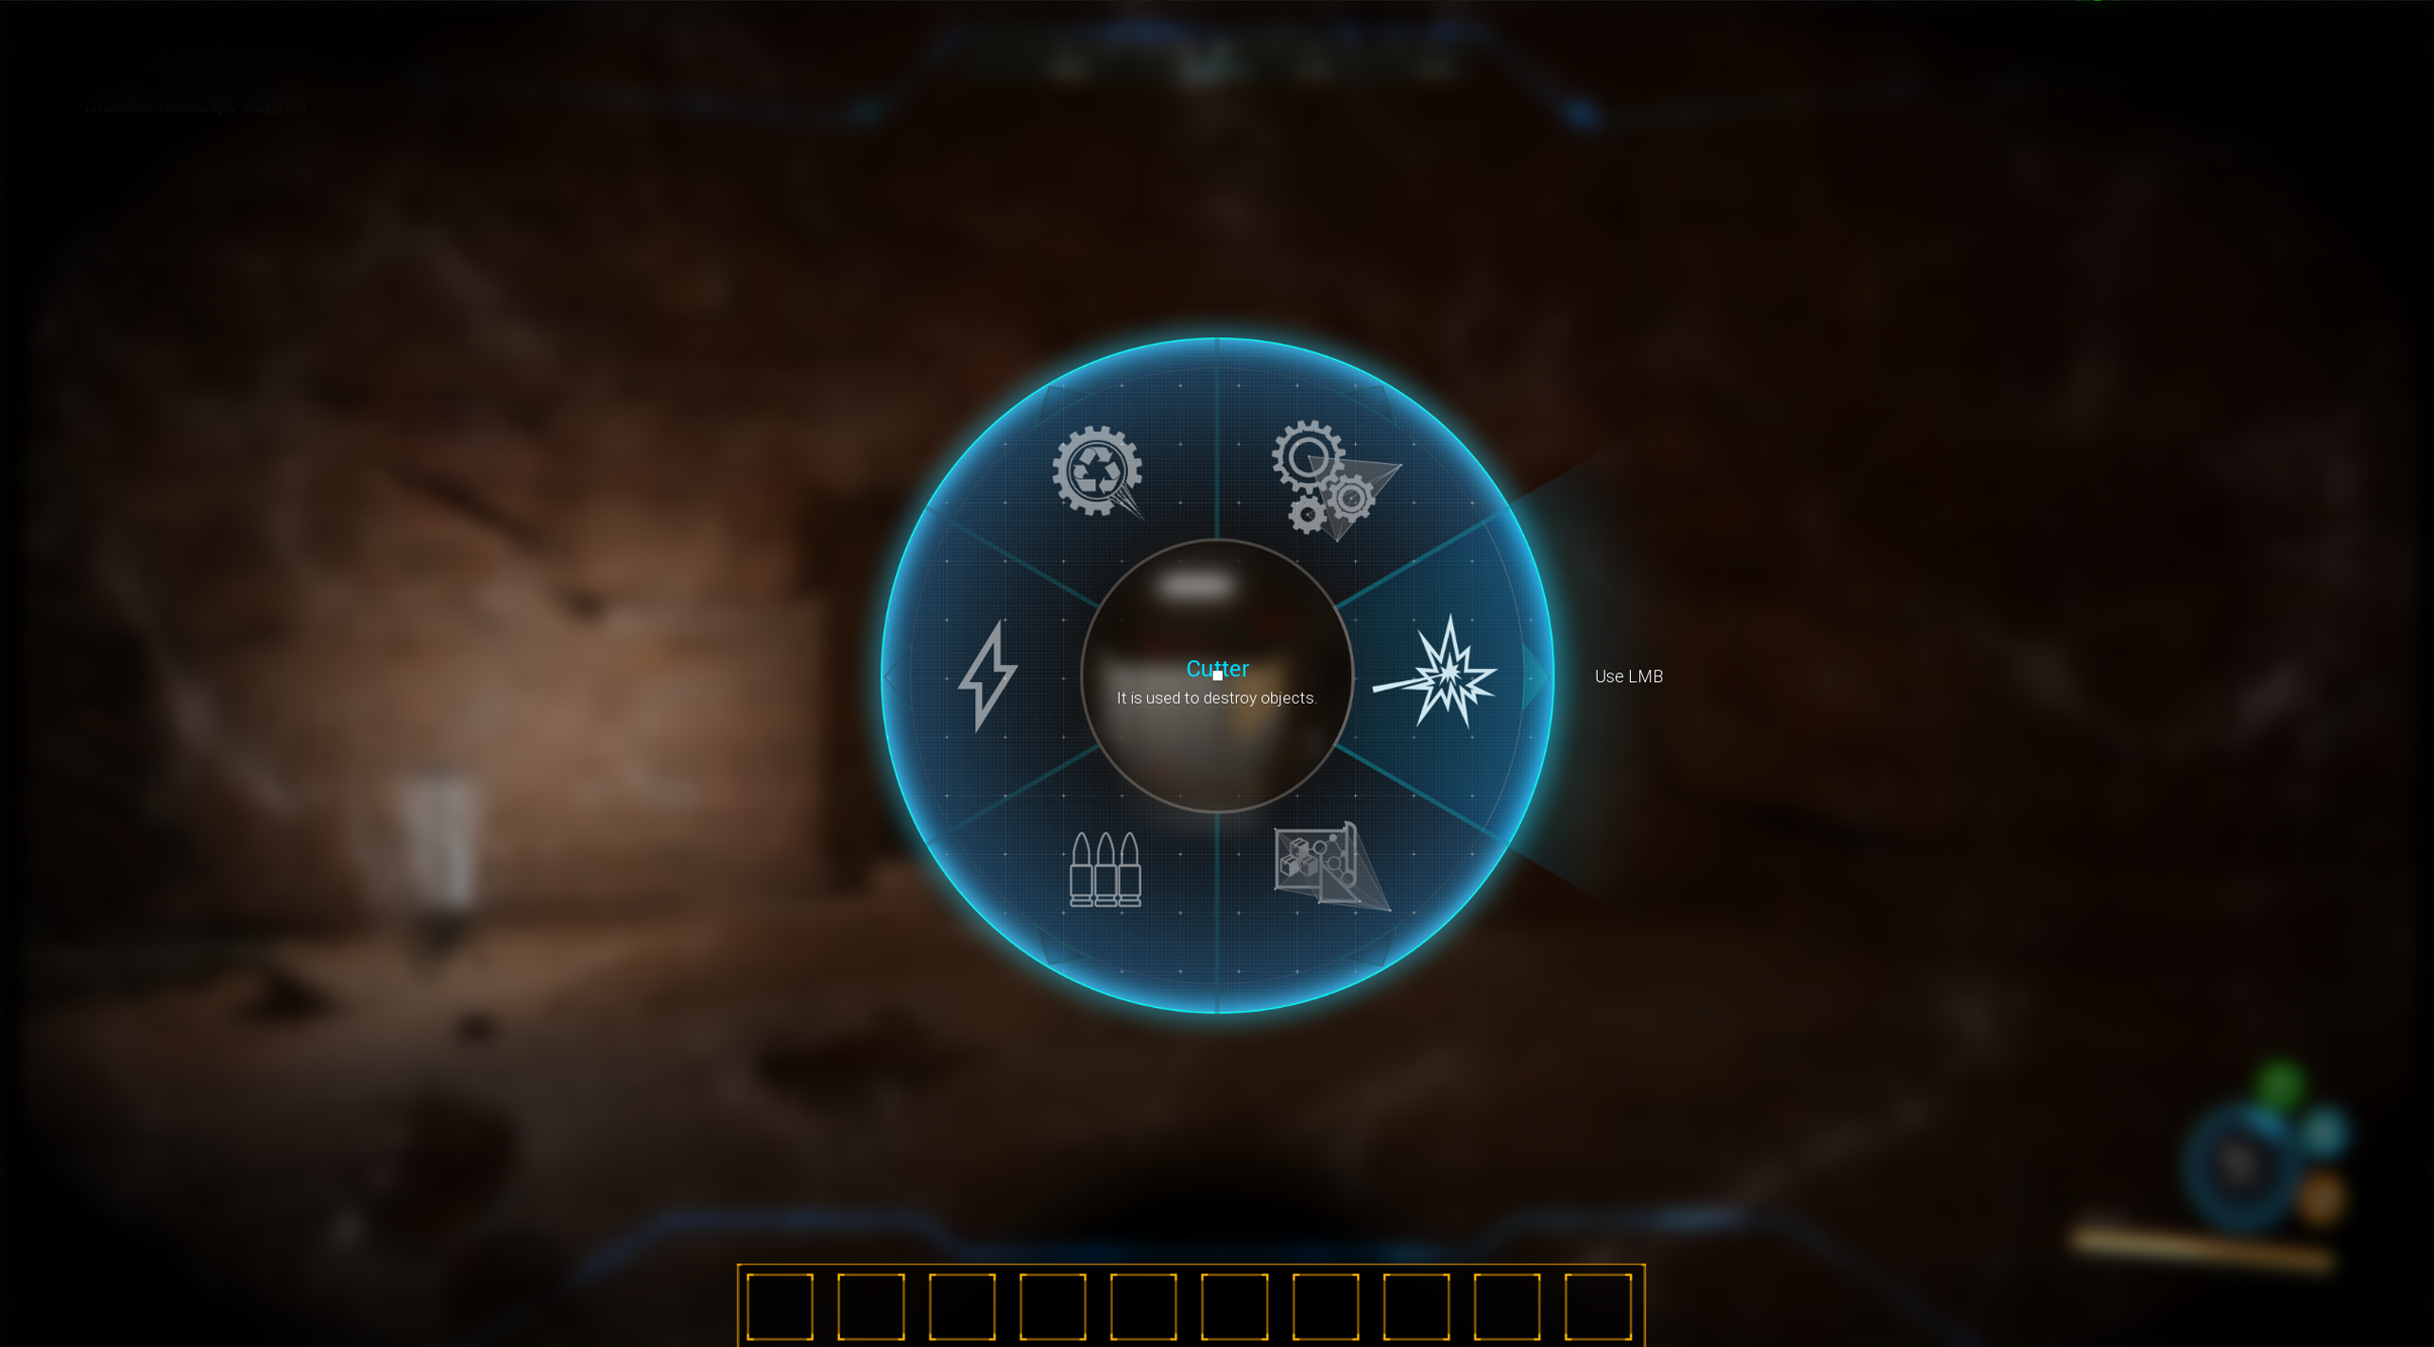
The game is rich in atmospheric details in many aspects. Sandstorms Radiation zones Temperature conditions Health Bar Oxygen Source Hunger Thirst Players experience effects depending on all situations. (Example) During a sandstorm, players may face the risk of their helmets cracking and breaking. As a result, survival tools have enhancements and level upgrades accordingly.
FP Hud Screen Parallax Helmet Cam

Slide 17
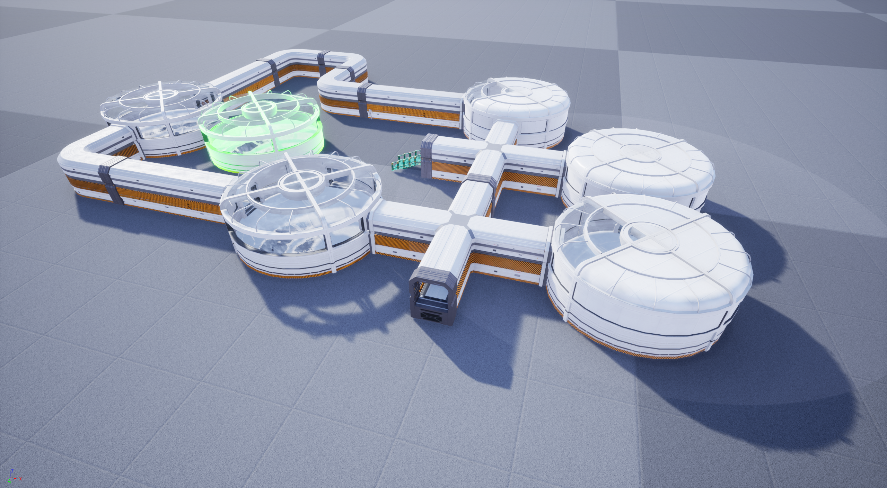
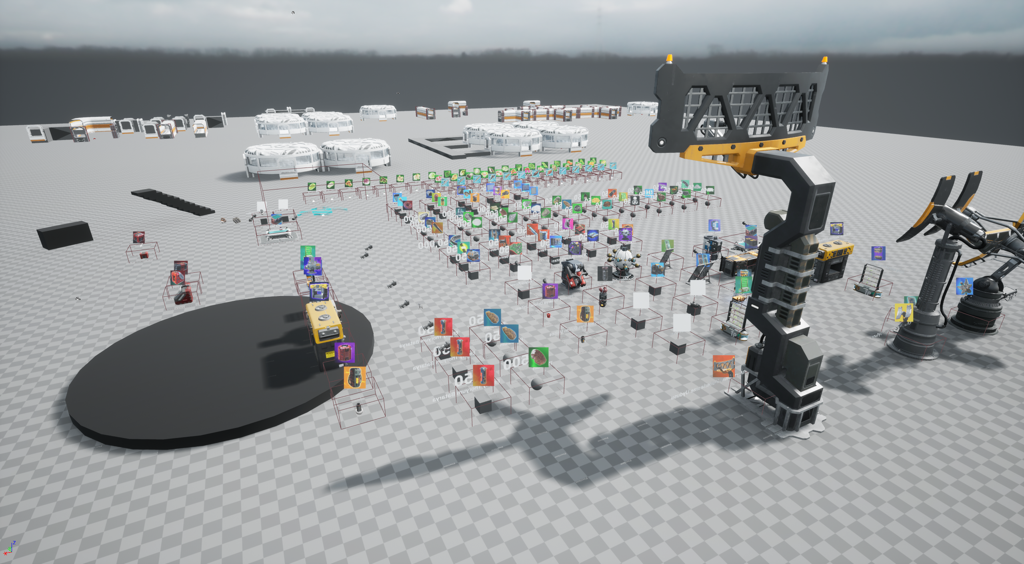
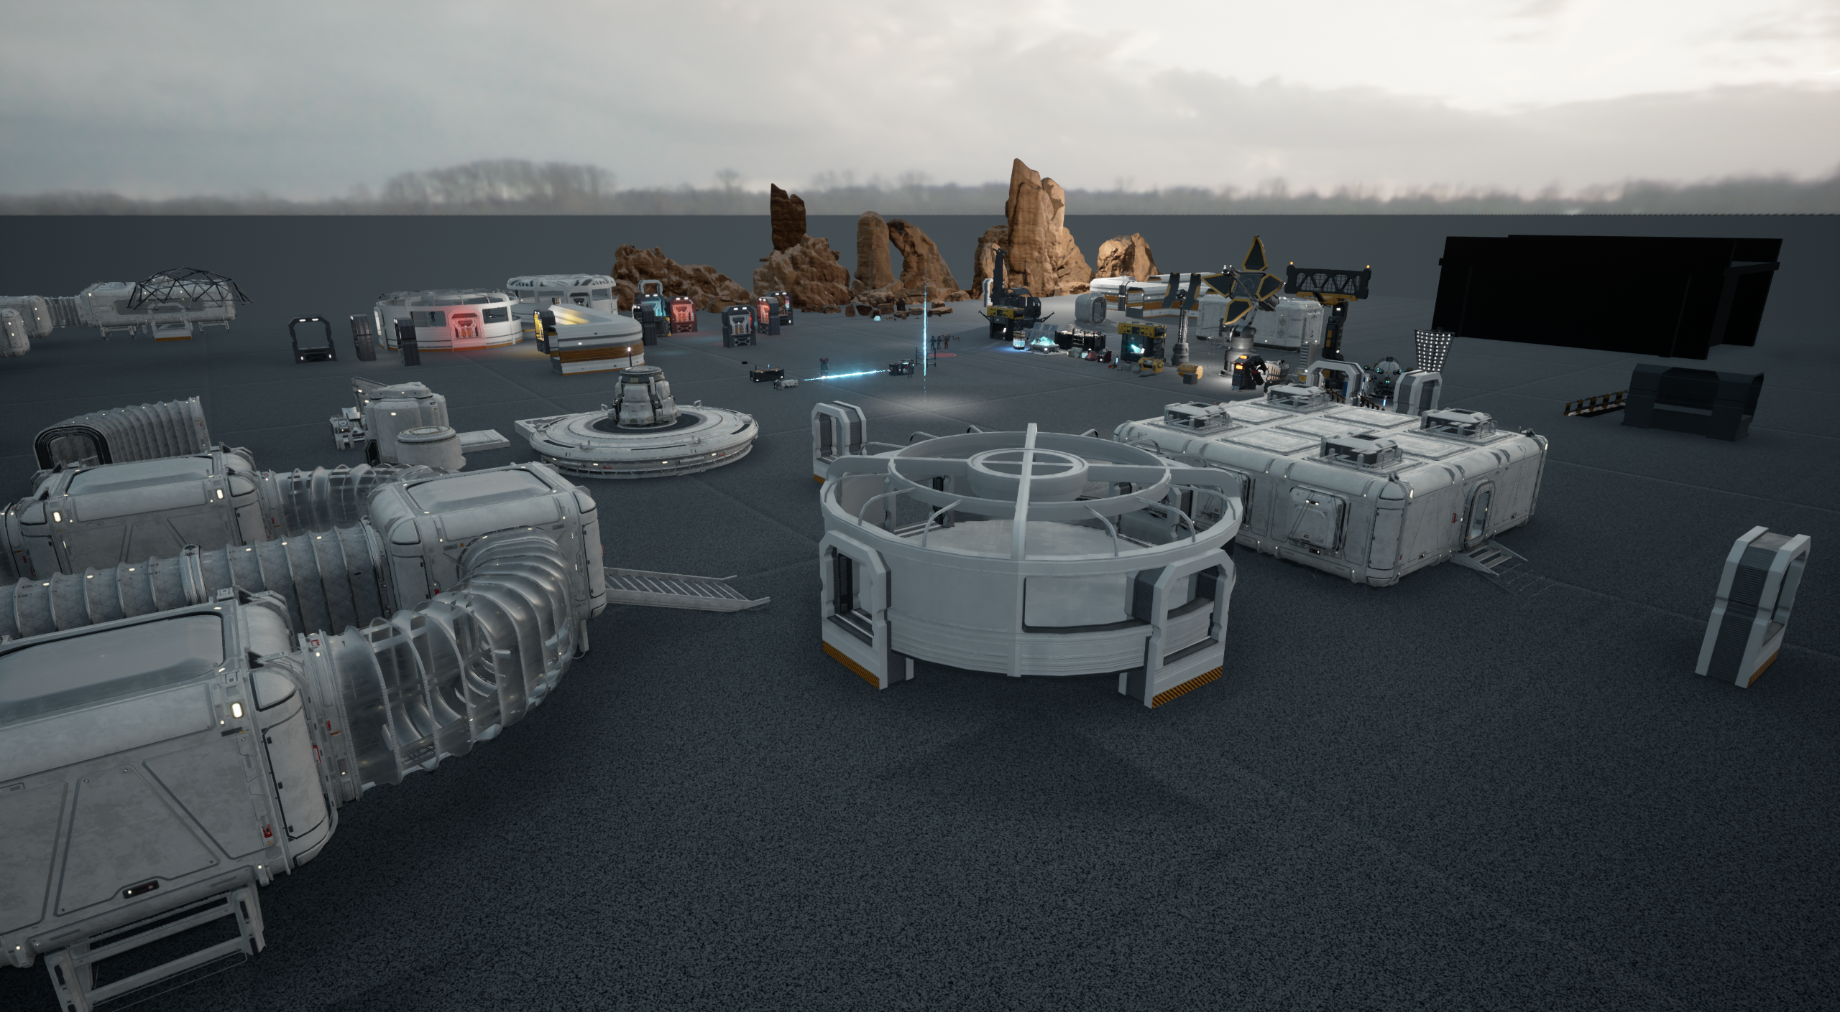
Targeted Platforms: Xbox SX – PS4/5
2025/October
Development Test Content

